Slide 1

Animation loop goes here

Slide 2
Commercial Services

Slide 3
PATIENT DRIVEN. POWERED BY EVIDENCE.
Redefining the future of pharmaceutical services
Agile services to power your products throughout their lifecycles Scalable from ultra-orphan, core specialty, through retail blockbuster

Slide 4
PILLARS OF FOCUS
3
We promise you:
Deep market expertise to design, implement, and operate a patient support program that will differentiate your brand in the market.
You can promise your patients:
Tireless help in overcoming financial, administrative, and clinical hurdles to enable them to start and stay on their course of therapy.
ENGAGING PATIENTS TRANSFORMING CARE CONNECTING HEALTH

Slide 5
ENGAGING PATIENTS TRANSFORMING CARE CONNECTING HEALTH
BREADTH AND DEPTH IN OUR CORE SERVICES
CONNECTED HEALTH
ACCESS SERVICES
CLINICAL EDUCATION
CARE COORDINATION
OUTCOMES & VALUE

Slide 6





HARNESSING TECHNOLOGY FOR BETTER OUTCOMES
Connected Health
SERVICE THAT SETS US APART
R_{x}
Electronic enrollments and consents / PBM card search / Payer type classification
/ eBV for pharmacy and medical / Hub assisted ePA / Electronic income verification
BENEFITS THAT MATTER
Speed to therapy + Improve awareness + Drive efficiency + Increase accuracy

Slide 7

A UNIQUE COMBINATION OF INDUSTRY INSIGHTS AND ADOPTION OF EMERGING TECHNOLOGIES
Connected Health
UBC PATHWAYS™
R_{x}
eEnroll
eBV
ePA
eIV
electronic enrollment
patient-level benefit verification for medical and pharmacy benefits
real-time prior authorization determination
qualifies patients for Patient Assistance through real-time income verification
eConsent
Re-Verify
Protect
electronic signature capture
identifies patients who have changed benefits
confirms which patients are eligible for financial support

Slide 8
A UNIQUE COMBINATION OF INDUSTRY INSIGHTS AND ADOPTION OF EMERGING TECHNOLOGIES
Connected Health
UBC PATHWAYS™
R_{x}
Monitor
Policy
Nexus
proactively monitors patients for benefit changes
delivers detailed policy information when PA is required
prescription support embedded in prescriber workflows
Engage
Accumulator
Med D
COB
connects patients, prescribers, and caregivers through omnichannel solutions
finds patients who are in plan designs where the accumulator is not reduced when financial support is provided
progresses toward and out of donut hole
benefit listing rules indicate payer preference based on coverage

Slide 9


Access Services
INITIATING THERAPY WITH EMPATHY AND DETERMINATION
SERVICES THAT SET US APART
Enrollment / Eligibility and coverage / Benefit verification / Prior authorization and appeal / Multi-channel pharmacy solutions / Personalized case management / Affordability / Field reimbursement
BENEFITS THAT MATTER
Reduce abandonment + Speed to coverage + Comprehensive results

Slide 10


Access Services
INITIATING THERAPY WITH EMPATHY AND DETERMINATION
A SIGNIFICANT IMPACT ON HEALTHCARE
On average, we handle 1.8M high-touch calls
each year
300K patients are enrolled in our PAPs annually
REIMBURSEMENT
AFFORDABILITY
This resulted in
X pharmacy triages in under Z days
In 2017, we conducted 135K benefit investigations...
Over $X in patient savings through co-pay
Completed Z alternate funding searches when no other options were available
...of which N were complex Medical+PBM. We supported 45K prior authorizations and 7K appeals

Slide 11

ACTIVE, PERSONALIZED ENGAGEMENTS
Clinical Education
SERVICES THAT SET US APART
Patient Services
Disease awareness / Therapy navigation / Therapy expectations / Side effect awareness / Education [Drug, Device, Program Services, Indications]
Program Promotion
Welcome calls / Follow-up calls / Brands / Services / Wellness / Personalized, patient-centric adherence programs
/ Transition services / Fulfillment processing
R_{x}
BENEFITS THAT MATTER
Create positive outcomes + Maximize compliance / persistency opportunities
+ Bridge patient / caregiver knowledge gaps + Empower and assure patients

Slide 12
ACTIVE, PERSONALIZED ENGAGEMENTS
Clinical Education
UBC NURSES: Reinforcing patient education
“
I am very emotional about the whole thing and your information
”
has been very helpful. My treatment plan all makes sense now.
“
— Patient
R_{x}
Educating patients on how their medication works and potential side effects they may experience
”
increases patient adherence maximizing their individual outcome with therapy. Being available
for patients and addressing each patient individually is very rewarding as a nurse.
“
— UBC Nurse Clinician
When I opened the box I was really scared. But then, I realized I had talked
”
with the nurses. They explained things and they are available. I cannot say
enough about your organization and service.
“
— Oncology patient
Ensuring each patient has therapy specific information is important for their adherence to therapy.
This is especially true when there are potential side effects that can affect patient adherence. It is
”
very rewarding to be that resource for each patient and see them through starting a new therapy.
— UBC Nurse Clinician

Slide 13


NAVIGATING THE COMPLEX PATH TO IMPROVED OUTCOMES
Care Coordination
SERVICES THAT SET US APART
Injection site coordination / Home care coordination / Site of care selection
/ Transition services / Labs / Phlebotomy coordination / Coordination of services
R_{x}
BENEFITS THAT MATTER
Promote positive patient journey + Aid ongoing therapy + Reduce barriers to therapy
+ Align with care plans + Provide options + Support program objectives

Slide 14

LEARNING, OPTIMIZING, AND ADVANCING CARE
Outcomes & Value
SERVICES THAT SET US APART
Linked data sources / Descriptive statistics / Visual dashboards / Data feeds / Prescriptive algorithms
R_{x}
BENEFITS THAT MATTER
Understand performance of programs + Maximize value to patients and payers + Demonstrate where program changes can improve outcomes

Slide 15
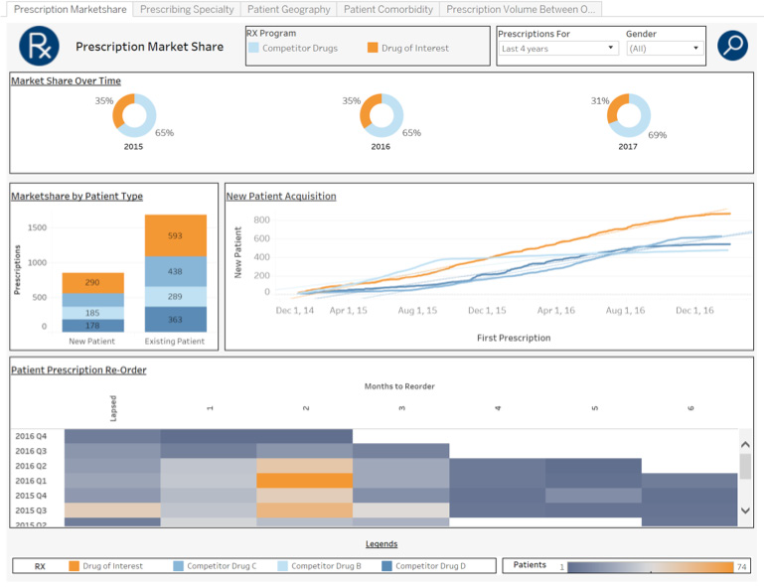
Outcomes & Value
LEARNING, OPTIMIZING, AND ADVANCING CARE
LONGITUDINAL DATA / VISUAL INSIGHTS / PRESCRIPTIVE SOLUTIONS
R_{x}
Cohort comparisons (in/out of patient support services)
Physician behavior and propensity to write Compliance and persistency curves Market share analysis
Withdrawal analysis Payer analytics
Turn-around time analysis

Slide 16
Outcomes & Value
LEARNING, OPTIMIZING, AND ADVANCING CARE
CLAIMS LINKING & COMPARISONS – Patient Compliance
R_{x}
Duration of continuous therapy
100
80
% patients on therapy
60
Hub patients are 20% more compliant to therapy
40
20
HUB patients (n=1,081) Non-HUB patients (n=417)
90 120 150 180 210 240
Number of days of continuous medication refilling
0
30
60
270
300

Slide 17
IMPROVING JOURNEYS AND OUTCOMES THROUGH A PATIENT-FOCUSED CULTURE, OPTIMIZED TECHNOLOGY, AND DATA-DRIVEN INSIGHTS
ENGAGING PATIENTS / TRANSFORMING CARE / CONNECTING HEALTH
CONNECTED HEALTH
ACCESS SERVICES
CLINICAL EDUCATION
CARE COORDINATION
OUTCOMES & VALUE

Slide 18
Patient Driven. Powered by Evidence.
Commercial Services

